Slide 1
Frame, Chebyshev conjugate gradient Algorithms
Summary for Papers to Literature Review

Slide 2
What can be included in literature review:
Conduct a literature review (mention relevant papers and attribute results to researchers). Make it as self-contained as you can.
Provide motivation for why the problem/topic is interesting.
What interesting problems remain.
Does it have applications.
What areas of math does it affect.
Provide brief review of background needed to understand the problem/topic. The main exercise is to create a coherent and well-motivated report/presentation, rather than presenting highly technical proofs. In fact, you don’t have to include proofs unless you want to, but it would be great if you can mention where the proofs can be found as part of the literature review.

Slide 3
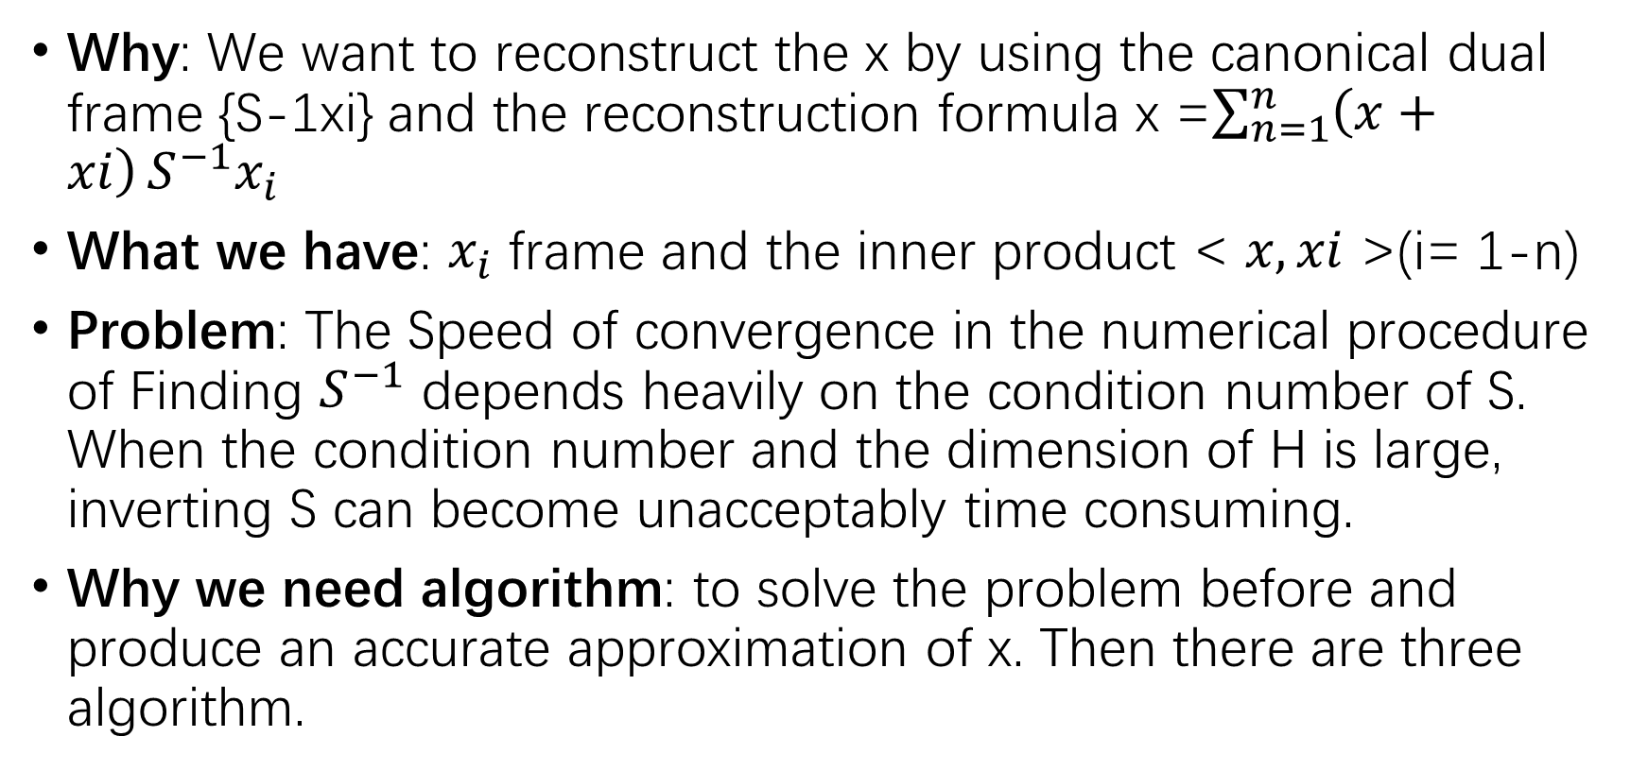
Frame to Undergraduate 3.7
Why: We want to reconstruct the x by using the canonical dual frame {S-1xi} and the reconstruction formula x =$\sum_{n=1}^{n}{\left(x+xi\right)}S^{−1}x_{i}$
What we have: $x_{i}$ frame and the inner product < $x,xi$ >(i= 1-n)
Problem: The Speed of convergence in the numerical procedure of Finding $S^{−1}$ depends heavily on the condition number of S. When the condition number and the dimension of H is large, inverting S can become unacceptably time consuming.
Why we need algorithm: to solve the problem before and produce an accurate approximation of x. Then there are three algorithm.

Slide 4
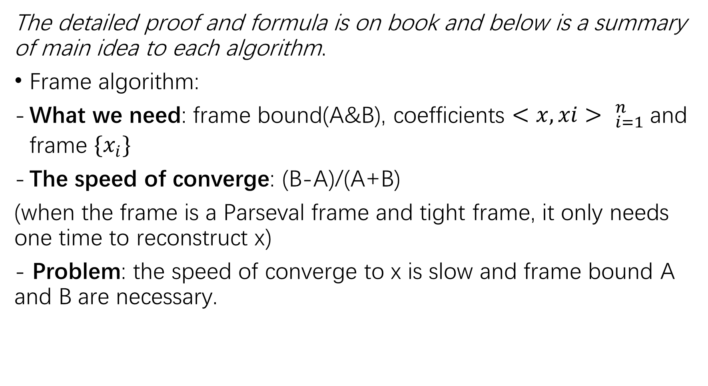
The detailed proof and formula is on book and below is a summary of main idea to each algorithm.
Frame algorithm:
What we need: frame bound(A&B), coefficients ${<x, xi> }_{i=1}^{n}$and frame ${\{x_{i}\}}_{}^{}$
The speed of converge: (B-A)/(A+B)
(when the frame is a Parseval frame and tight frame, it only needs one time to reconstruct x)
- Problem: the speed of converge to x is slow and frame bound A and B are necessary.

Slide 5
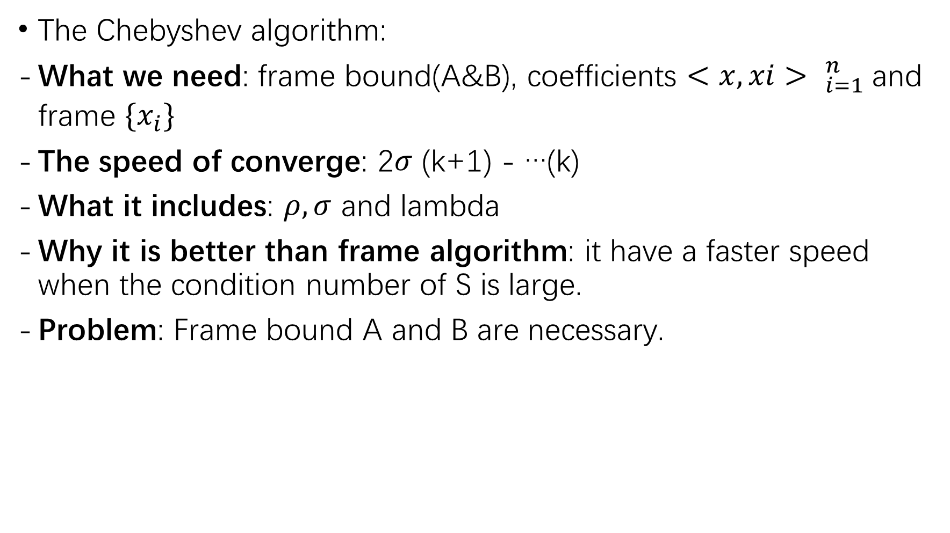
The Chebyshev algorithm:
What we need: frame bound(A&B), coefficients ${<x, xi> }_{i=1}^{n}$and frame ${\{x_{i}\}}_{}^{}$
The speed of converge: 2$σ$ (k+1) - …(k)
What it includes: $ρ, σ$ and lambda
Why it is better than frame algorithm: it have a faster speed when the condition number of S is large.
Problem: Frame bound A and B are necessary.

Slide 6
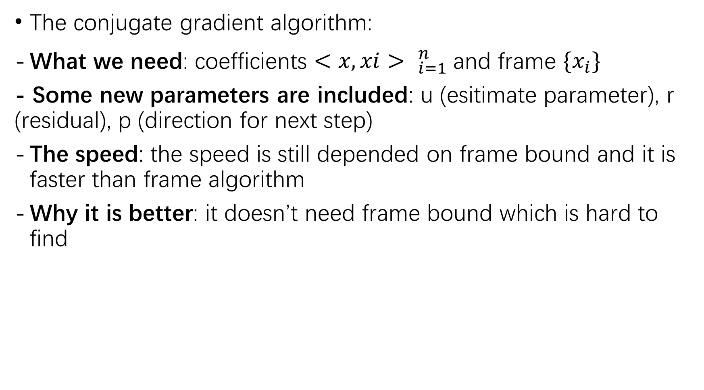
The conjugate gradient algorithm:
What we need: coefficients ${<x, xi> }_{i=1}^{n}$and frame ${\{x_{i}\}}_{}^{}$
- Some new parameters are included: u (esitimate parameter), r (residual), p (direction for next step)
The speed: the speed is still depended on frame bound and it is faster than frame algorithm
Why it is better: it doesn’t need frame bound which is hard to find

